Slide 1

VOICE-BASED AI MENTAL HEALTH ASSISTANT FOR EMOTIONAL SUPPORT

Slide 2

TEAM DETAILS
P. LAKSHMI PRIYA
KOTA SAI
VASAVI
N. SATHYA
SRI
ROLL NO: 23R11A6284
ROLL NO:
23R11A05X0
ROLL NO:
23R11A67G6

Slide 3
Problem Statement
Many people suffer from stress, anxiety, and depression but lack access to timely mental health support due to stigma, cost, and shortage of professionals. There is a need for a safe, accessible, and non-judgmental platform for emotional assistance.
Proposed Solution
A Voice-Based AI Assistant that offers 24/7 emotional support using speech recognition, NLP, and emotion detection. It provides mood tracking, mindfulness exercises, and motivational feedback while maintaining user privacy and suggesting help in high-risk cases.

Slide 4
Abstract / Overview:
This project presents a Voice-Based AI Mental Health Assistant designed to provide emotional support through natural, empathetic conversations. It uses technologies such as Automatic Speech Recognition (ASR), Natural Language Processing (NLP), and emotion detection to understand user emotions and respond accordingly. The goal is to offer a private, accessible, and always-available companion to support mental well-being, especially in environments lacking professional care.

Slide 5
Existing System
Most current apps (e.g., Wysa, Woebot) offer text-based chatbots.
Lack real-time voice interaction and deep emotional understanding.
Often limited in providing personalized, emotion-aware responses.
Users may feel disconnected due to robotic or scripted replies.
Proposed Solution
A Voice-Based AI Assistant that interacts naturally via speech.
Integrates ASR, NLP, and emotion detection for empathetic conversations.
Offers mood tracking, guided mindfulness, and motivational feedback.
Provides non-judgmental, 24/7 emotional support with privacy and safety features.

Slide 6

Technologies Used:
Frontend: HTML, CSS, JavaScript (for chatbot UI)
Backend: Python, Streamlit
Libraries/Tools: SpeechRecognition, NLTK, TextBlob, pyttsx3
AI/ML: NLP models, Sentiment analysis, ASR engines (e.g., Google Speech API)

Slide 7
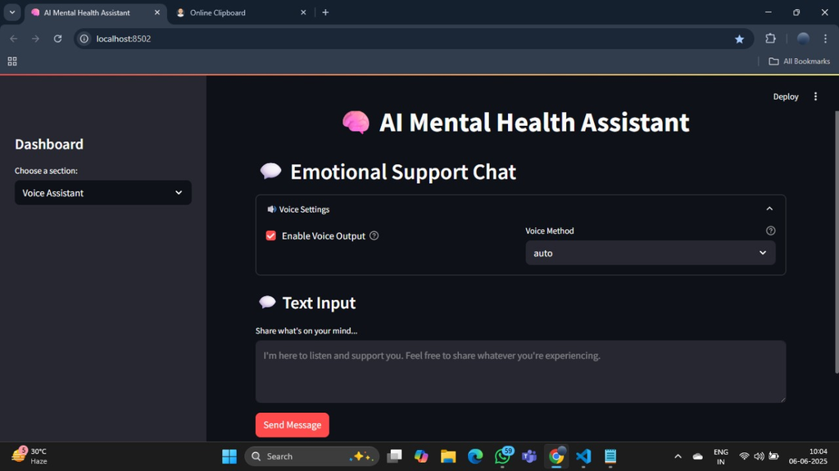
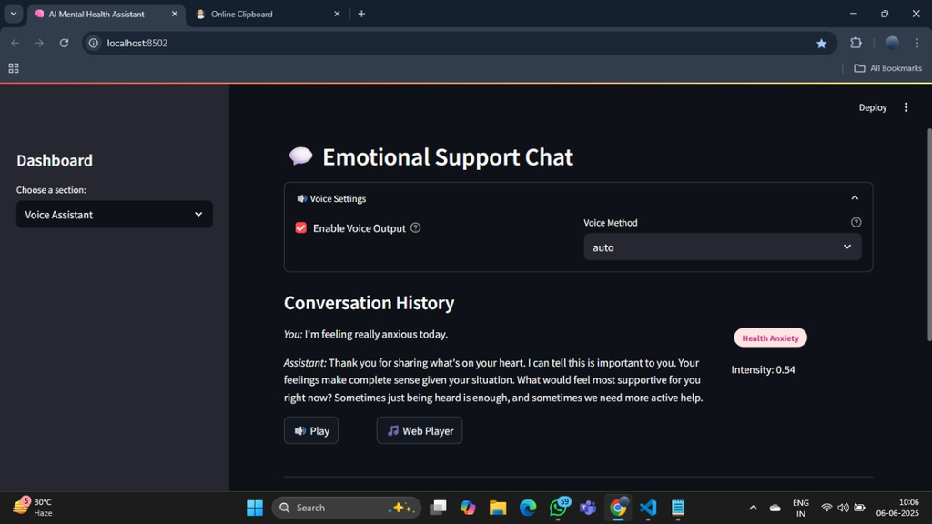
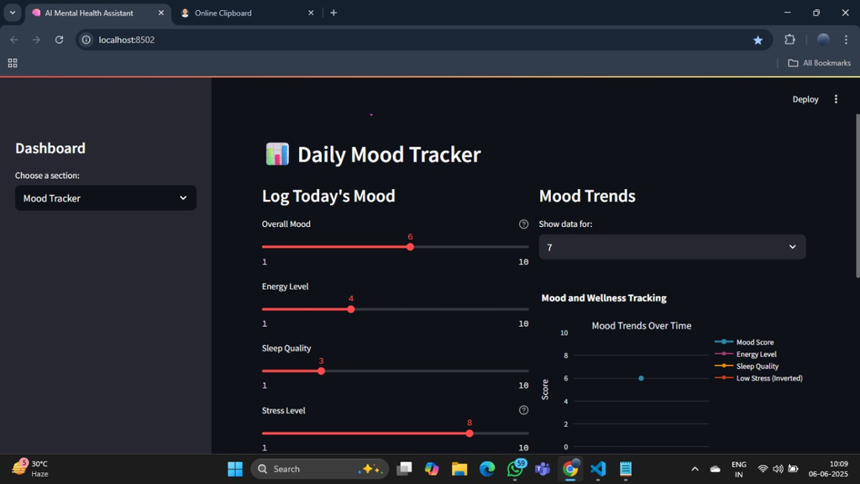
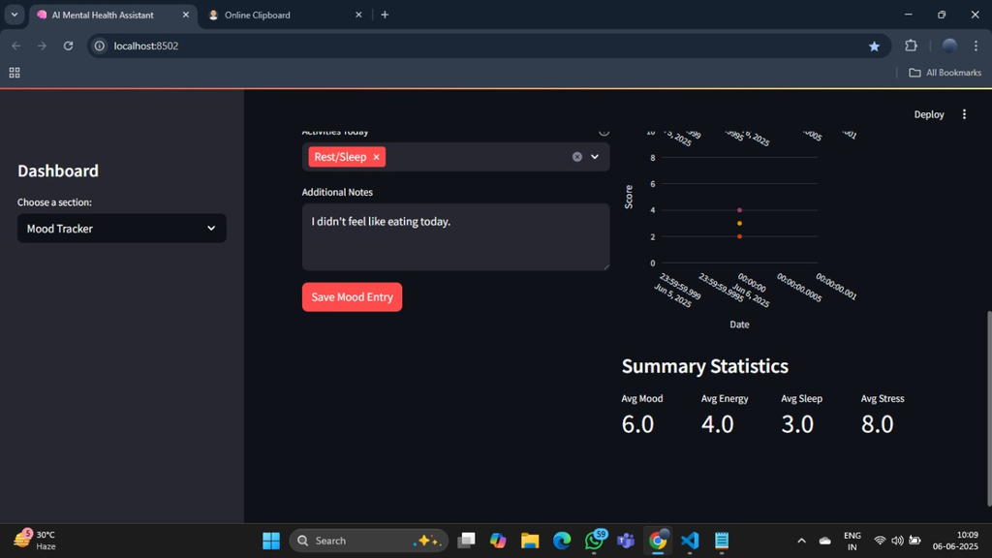

Slide 8
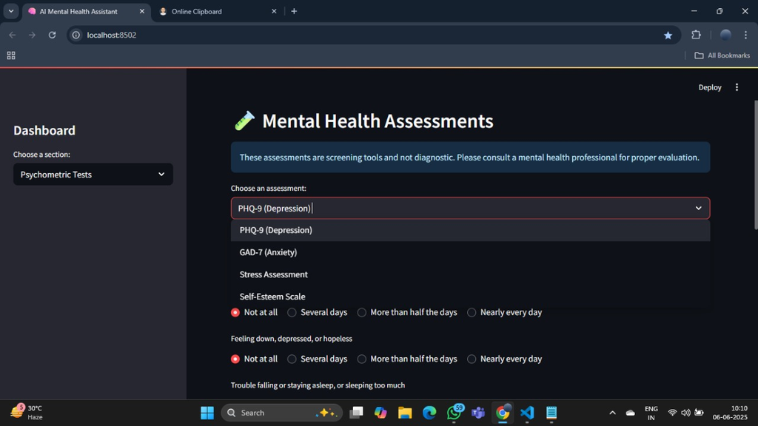
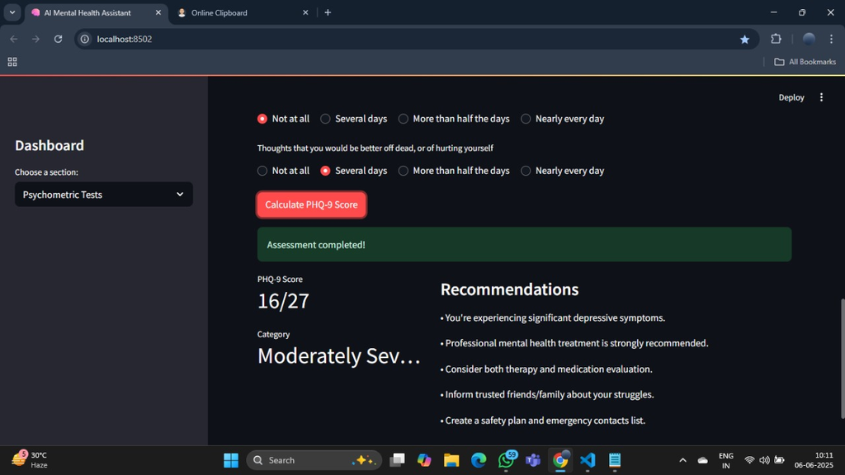
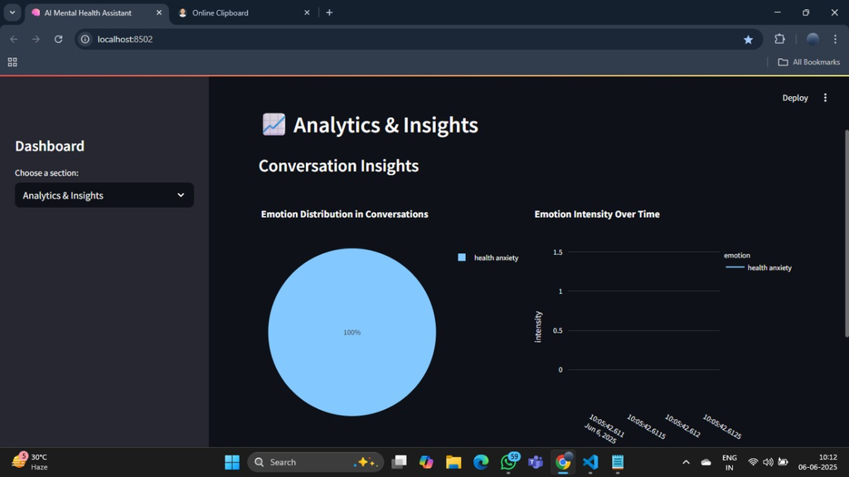
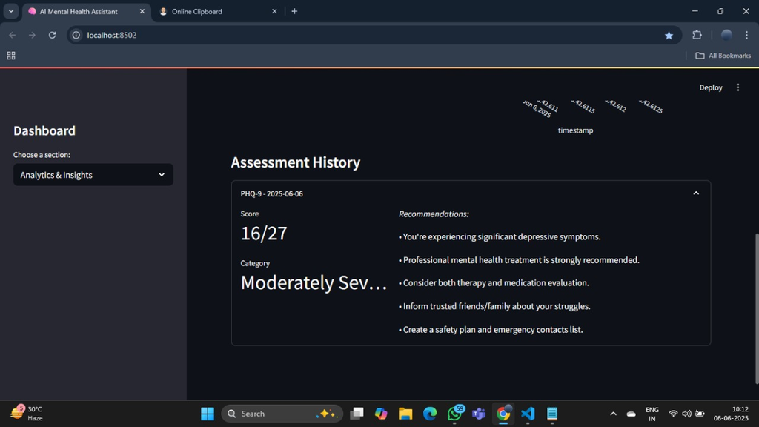

Slide 9
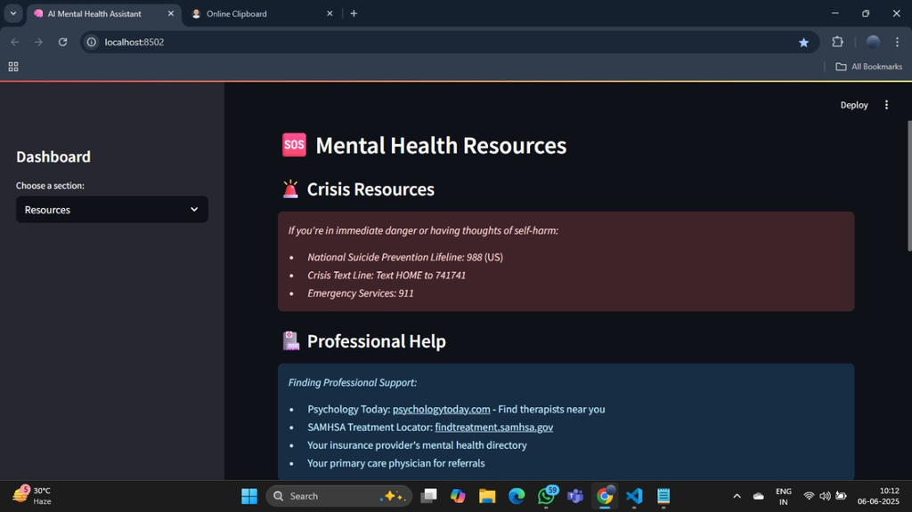
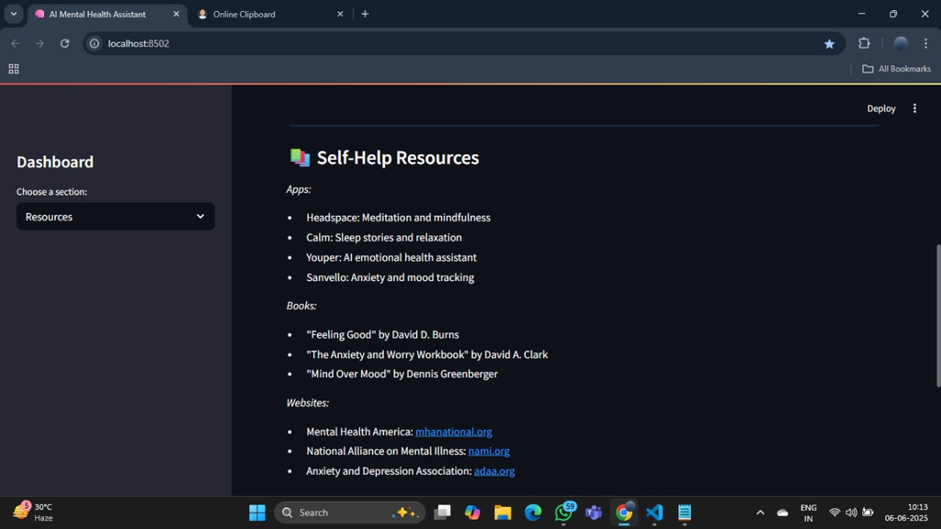
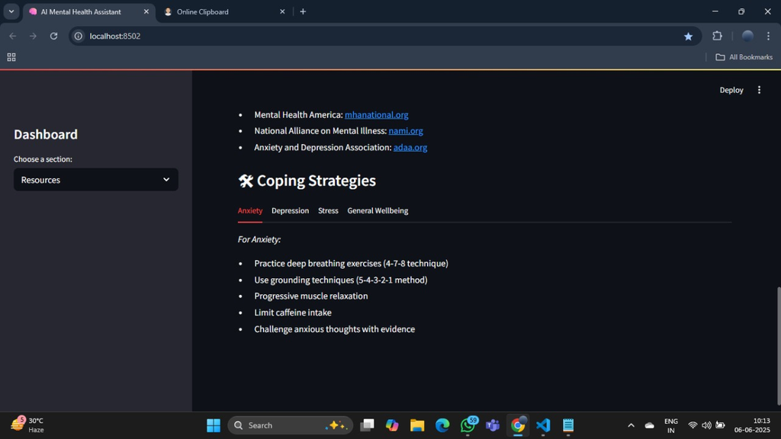

Slide 10
Conclusion-
The Voice-Based AI Mental Health Assistant provides accessible, empathetic, and real-time emotional support using speech and AI technologies. It helps users manage stress and emotions while maintaining privacy.
Future Enhancements:
-->Add multilingual support
-->Develop mobile app version
-->Integrate facial emotion recognition
-->Connect with real therapists in critical cases
-->Let me know if you want this in bullet format or visual layout.

Slide 11
THANK YOU

